Slide 1


Renovate with Confidence. Your Vision, Our Expertise. Dare to Dream, Renovate with Glee.
Sean Cosenza, Kim Metzger, Rakesh Rai, and Chris Whitehead
Notes:
Introduction
In today’s fast-paced environment, efficiency, cost-effectiveness, and seamless project execution are essential for successful home improvement projects. The integration of artificial intelligence (AI) into project management tools can revolutionize how we approach home improvement tasks, from planning to execution. This presentation outlines the rationale for adopting an AI-powered project management tool tailored for home improvement, highlighting its benefits, features, and potential impact on our organization.
Introduction (Sean):
Imagine a world where the home improvement industry is seamlessly managed by a revolutionary AI-powered platform. That's what HomeGlow is building. We're developing a single-click application for comprehensive home renovation projects that leverage cutting-edge technology to streamline the entire process from finding skilled contractors to selecting design and finishes to ordering appliances and materials and even integrating Tesla Optimus for household chores. We are fundamentally transforming the construction landscape.
If you’ve ever made renovations to your home, you understand the challenges and frustrations faced when coordinating multiple contractors, managing budgets, and making informed decisions on design and finishes.
Our founders consist of four talented and diverse Our founders consist of four talented and diverse business leaders – including Sean Cosenza, Kim Metzger, Rakesh Rai, and Chris Whitehead – who have 83 combined years of experience in the business leadership in real estate development, sales and service roles in the home renovation space, software development leadership across diverse industries, including Finance, Healthcare, and Technology and study of higher education curriculum. Together we account for a highly effective, qualified, and passionate group of professionals who have identified a unique need in the home improvement/construction industry and seek to bring solutions to this market.

Slide 2

Background
Current market landscape
Help fit consumer need
Consumer base/market demand
Problems (costs, time, hassles)
Notes:
Background
Home improvement projects often involve numerous moving parts—scheduling, budgeting, resource allocation, and vendor management. Many homeowners struggle to coordinate these tasks, leading to delays, cost overruns, and unsatisfactory outcomes. An AI-powered project management tool can streamline these processes by providing intelligent solutions to common challenges faced by homeowners and contractors.
AI and robotics are reshaping various industries, providing opportunities to enhance efficiency and customer experience. With Home Glow, the home improvement process leverages this technology to manage the entire workflow solution, enhancing convenience while empowering users to focus on their work and leisure.
The U.S. home remodeling market was valued at $432B in 2023 and is expected to increase at a compound annual growth rate of 4.8% between 2024 and 2032, a massive market currently underserved by existing solutions. Globally, the home remodeling market is valued in excess of $950B with a projected CAGR of 4.14% from 2024 to 2031.

Slide 3

Proposed Technology: AI-Powered Home Improvement Project Management Tool
AI-Driven Cost Estimation
Smart Resource Allocation
recommend the most cost-effective options
Resource Analysis Process
Data Collection
Inventory and Supplier Databases
Machine Learning Models for Cost-Effectiveness
Optimal Resource Recommendations
Notes:
AI-Driven Cost Estimation: Utilizing historical data and market trends, the tool can provide accurate cost estimates for materials and labor, helping users budget effectively.
Smart Resource Allocation: The tool can analyze available resources and recommend the most cost-effective options for completing projects, ensuring timely procurement of materials and labor.
For example, the AI-powered tool could leverage a combination of data sources, predictive algorithms, and machine learning models. Here’s how it might work in practice and how it could bridge a gap for clients:
Our strong team expertise and superior user experience positions Home Glow uniquely to maximize this opportunity. Proprietary applications incorporate AI-powered contractor finders that connect homeowners with skilled professionals for jobs such as plumbing, electrical, and carpentry. Our automated ordering system uses AI technology to assist in ordering construction materials, appliances, cabinets, and countertops, providing cost-effective options and timely deliveries. Through Tesla Optimus integration, robots handle household chores and food orders enhancing convenience for the homeowner whose environment has been turned upside down through construction.

Slide 4
Bridging a Client Gap
A CENTRAL, CLIENT-FRIENDLY PLATFORM
Transparent, Informed Decision-Making:
offering transparent cost breakdowns
End-to-End Project Optimization
tool bridges these steps into one streamlined system
Adaptive Learning
tool would continually learn from each project
Notes:
One major gap in the home improvement market is the lack of a central, client-friendly platform that seamlessly manages both the planning and procurement phases. Many clients feel overwhelmed by navigating multiple vendors, comparing fluctuating costs, and balancing quality with budget constraints.
Here’s how this tool could fill this void:
Transparent, Informed Decision-Making: By offering transparent cost breakdowns and recommendations backed by real-time data, the tool empowers clients to make confident decisions without extensive industry knowledge. They wouldn’t need to rely solely on contractors’ input or spend hours researching options.
End-to-End Project Optimization: Clients typically struggle with the disjointed nature of home improvement projects, often requiring separate tools for budgeting, sourcing, and scheduling. This tool bridges these steps into one streamlined system. By aligning budgeting, supplier selection, and scheduling, it reduces friction and creates a more cohesive, predictable experience.
Adaptive Learning: Since the tool would continually learn from each project, it could provide increasingly personalized recommendations for repeat clients, identifying their preferences and cost-saving patterns, which fosters loyalty and a sense of partnership.
By filling this gap, the tool could become an essential resource for clients, simplifying complex decisions, providing cost transparency, and reducing stress—all key value propositions in the home improvement industry.

Slide 5
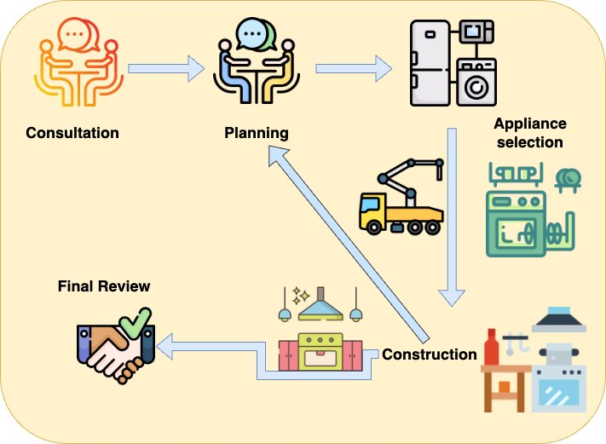
RENOVATION Process Flow
Five basic steps of home renovation service
Consultation.
Planning
Material Selection
Construction
Final review
Icon Source: https://www.freepik.com/icons
Notes:
To further illustrate the potential of an AI-powered project management tool, consider a hypothetical case study where a homeowner embarks on a kitchen renovation. Using the tool, the homeowner receives a detailed budget estimate that incorporates costs for materials and labor, schedules the project phases based on contractor availability, and visualizes the renovation through AR. The result is a completed project within budget and ahead of schedule, showcasing the tool's effectiveness.

Slide 6
Website Demo
https://homeglowpsu.github.io/homeglow/
Dare to Dream, Renovate with Glee.
Notes:
By filling this gap, the tool could become an essential resource for clients, simplifying complex decisions, providing cost transparency, and reducing stress—all key value propositions in the home improvement industry.
Project Planning and Scheduling: AI algorithms can optimize project timelines, adjusting for delays and resource availability, which helps in maintaining project momentum.
Augmented Reality (AR) Integration: Users can visualize their projects using AR technology, allowing them to see how proposed changes will look in real-time, enhancing decision-making.
Invoicing and Payment Tracking: The tool simplifies financial management by generating invoices and tracking payments, which reduces administrative overhead and improves cash flow management. Benefits of Implementation
Increased Efficiency: By automating scheduling and resource management, the tool reduces the time spent on administrative tasks, allowing project managers to focus on execution.
Cost Savings: With accurate cost estimations and optimized resource allocation, homeowners can avoid unexpected expenses and make informed financial decisions.
Enhanced Decision-Making: AI-driven insights and AR capabilities empower users to make better design choices, leading to higher satisfaction with project outcomes.
Improved Communication: The tool facilitates collaboration between homeowners, contractors, and suppliers, ensuring everyone is aligned on project goals and timelines.

Slide 7
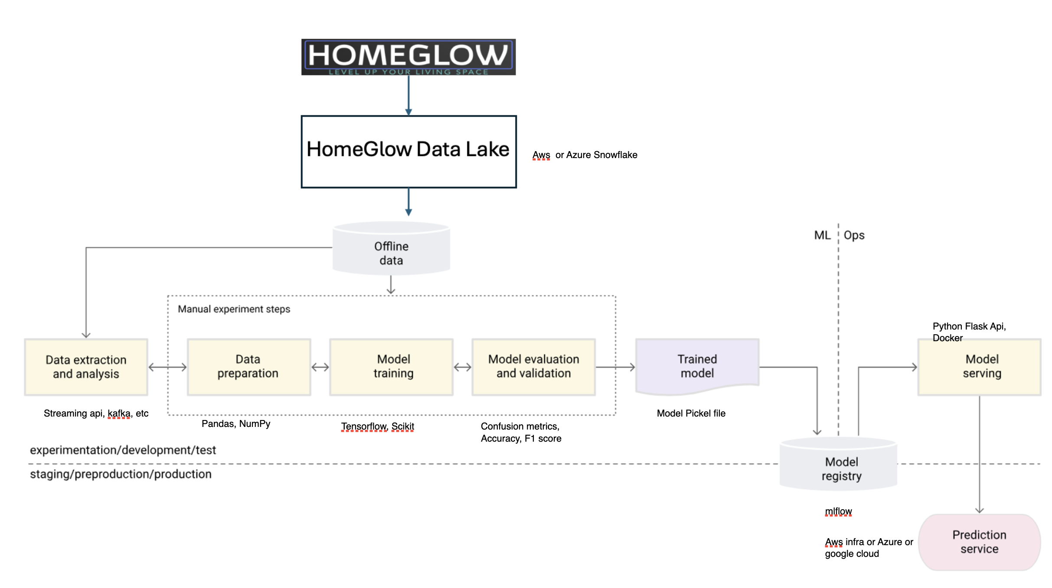
HG Data Analysis
Notes:
The workflow begins with the Home Glow application, where users perform transactions and make selections. This historical data is stored in a data lake, such as Snowflake or any cloud service providing lake access. This historical data is used for training our models. We load this offline data into the system using extraction tools like Kafka, streaming APIs, or Snowflake's built-in APIs. The first stage involves data extraction and analysis. We load and extract the offline data using various tools like streaming API / Kafka based on our data maintenance strategy. Next, we prepare the data by cleaning it and adding necessary columns, such as additional information based on ZIP codes. Once the data is prepared, it is used to train the prediction model. We use TensorFlow, a powerful Python module, to train various models like classifiers, neural networks, or convolutional neural networks (CNN) for image data. After training, we evaluate the model using testing or QA data to measure its accuracy. If the accuracy score is below our target, we retrain the model with additional data to improve accuracy.
Once the model achieves satisfactory accuracy, we register it using a model registry like MLflow. The model is then deployed on infrastructure such as Azure, containerized with Docker, and made available for prediction services via Flask, a Python API.

Slide 8
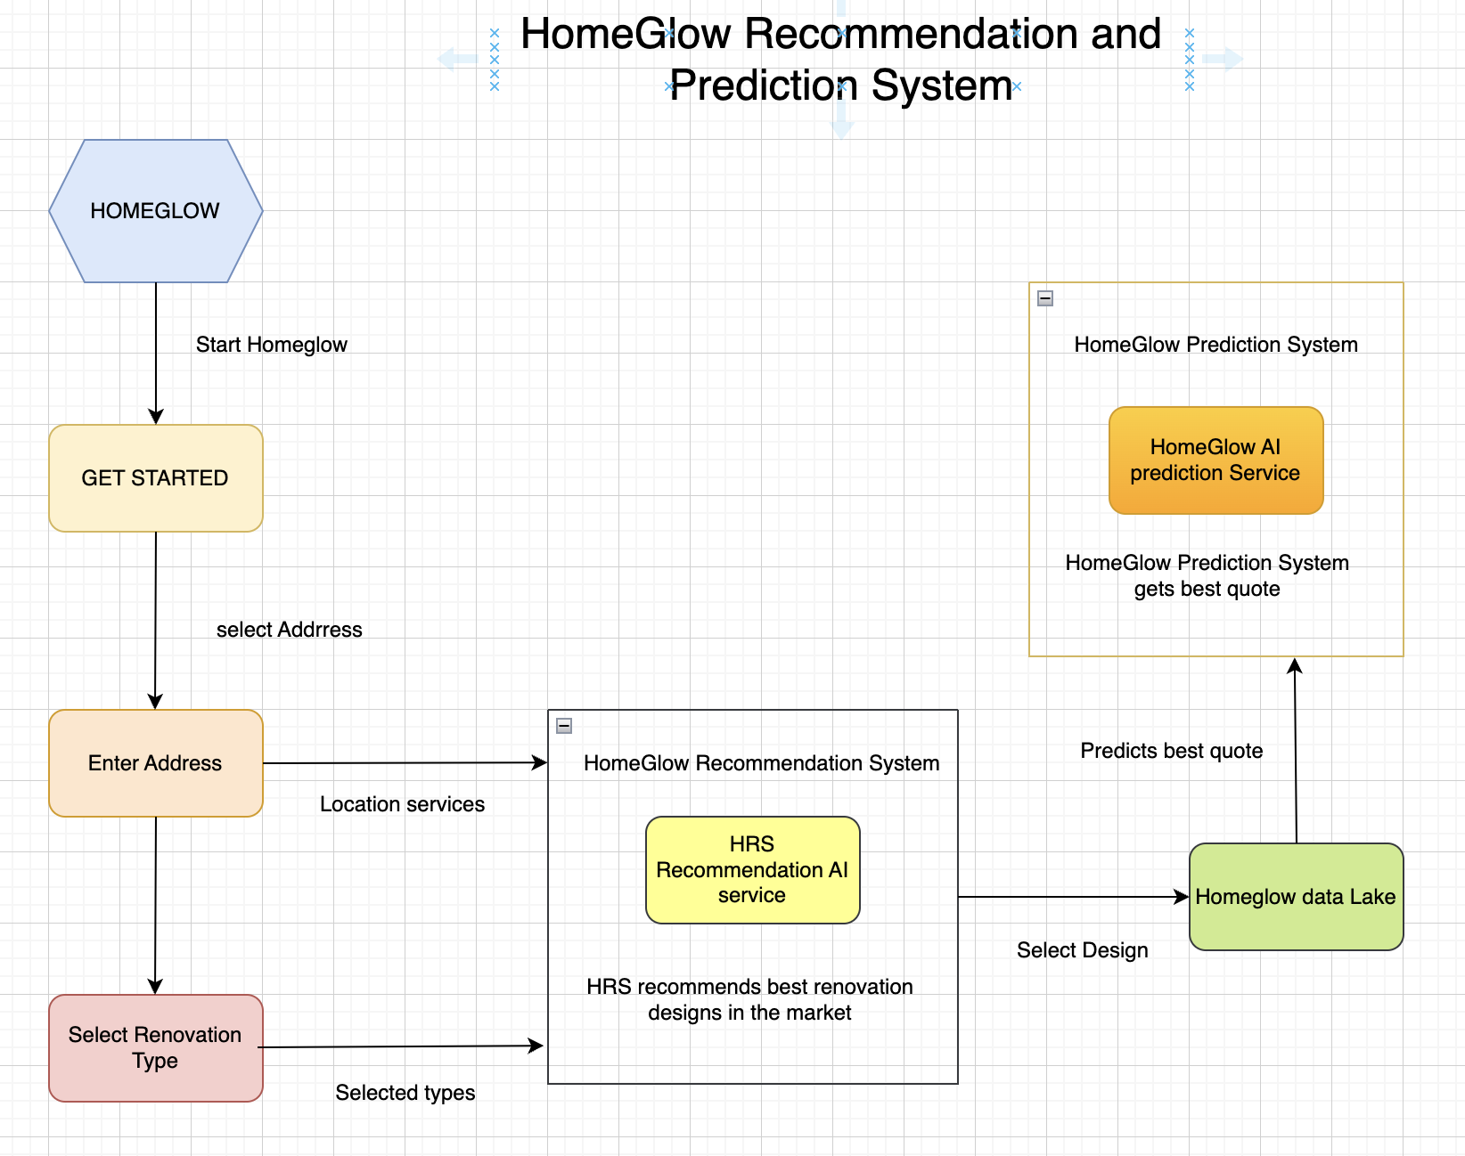
HG Prediction System
Notes:
The ML services help Home Glow users optimize their quotes and find the best designs in the market. When a user logs into Home Glow, the system fetches their location details and renovation preferences. This information is fed into the Home Glow recommendation system, which suggests the best available models and generates new designs based on user inputs and market needs. The recommendation system stores selected designs in the data lake for future training. The prediction system then provides the best quote for the selected design based on user interests and market rates. Notifications are sent to providers once a quote is selected, facilitating user interactions. Home Glow's innovative system leverages the latest ML services to generate and recommend designs, ensuring users get the best options and quotes available.

Slide 9

Strategic Alignment with Organizational Goals
Understanding Stakeholder Priorities
Enhancing the customer experience, reducing delays, and supporting future scalability (Forrester, 2024)
Business Outcomes
Enhanced Customer Experience
Personalized recommendations for new homebuyers
Collaborations with local stakeholders for real-time data
Increased Efficiency
Cost Optimization
Notes:
Understanding Stakeholder Priorities:
Project HomeGlow’s leadership prioritizes customer satisfaction, operational efficiency, and scalable growth.
The AI tool aligns with these priorities by enhancing the customer experience, reducing delays, and supporting future scalability (Forrester, 2024).
Business Outcomes:
Enhanced Customer Experience: Personalized project recommendations and real-time updates on progress.
Personalized Recommendations for New Homebuyers
Tailored Renovation Guides for Relocating Homebuyers: The tool could cater specifically to homebuyers relocating to an unfamiliar area by providing a “local renovation guide.” This guide would offer insights into typical design preferences, material durability for local climate conditions, and styles that match the local aesthetic.
Material Sourcing and Cost Forecasts: Leveraging regional and historical home data, the tool could even forecast the costs associated with different materials or design choices. For example, if slate roofing is popular in a historic North Carolina neighborhood but costly, the system could alert users to budget-friendly alternatives that maintain the aesthetic without sacrificing quality.
Collaborations with Local Stakeholders for Real-Time Data
Partnerships with HOAs and Planning Departments: Collaborations with HOAs and town planning departments would allow the system to provide real-time updates on local regulations, renovation restrictions, or incentives. This ensures homeowners are not only aware of the local style but also of any specific restrictions they must adhere to, which could be crucial in historically preserved areas.
Real Estate Insights on Neighborhood Profiles: By pulling in data from real estate listings and previous renovation costs in the area, the tool could offer newcomers valuable information on neighborhood profiles, including what types of renovations are standard or highly valued in each area.
Increased Efficiency: Automated scheduling and resource allocation to eliminate bottlenecks.
Cost Optimization: Predictive analytics to identify potential cost overruns before they occur.

Slide 10

Investor pitch
Market Analysis
Value Proposition & Business Model
Implementation
Financial Forecast
Risks & Mitigation
Funding Sources/Ask
Notes:
We will acknowledge potential constraints in our proposal, such as budget limitations, resistance to change, and the need for staff training. By applying Forrester’s guidance on risk assessment and mitigation strategies, we will outline how to overcome these challenges.
Risk Assessment
A. Identifying Risks
Discuss potential risks associated with the technology implementation (e.g., integration challenges, employee resistance, and data security concerns).
B. Mitigation Strategies
Propose strategies to mitigate identified risks, such as training programs and phased implementation (Forrester, 2024).
Structuring a strong business case, benefits, cost, flexibility, risk. “Forrester page 6.”
“traditional cost/benefit models may not apply”
“required metrics around customer engagement, agility, and efficiency/cost reduction are the same as for established technologies, the data and reference points may not be available”
“Technology leaders will have to use assumptions in their business case, a concept that may not sit well with data-focused leaders”

Slide 11
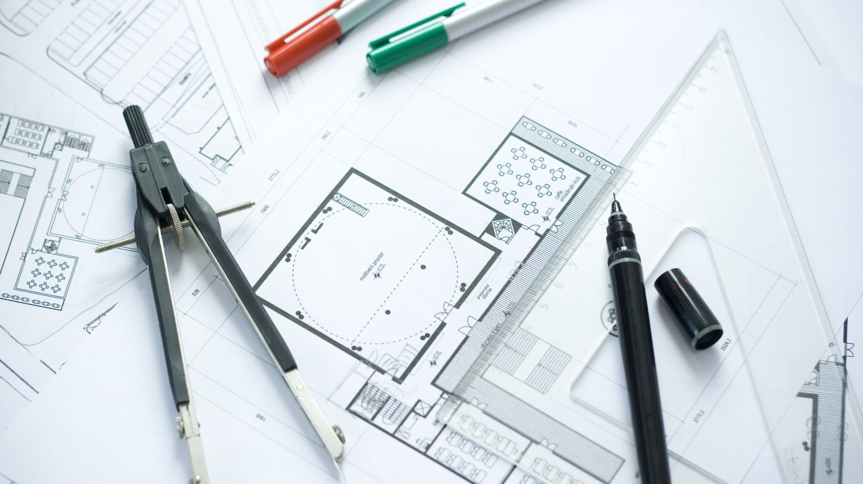
4-phase Implementation Plan
Notes:
Step-by-Step Roadmap:
Phase 1: Pilot Program: Deploy the AI tool in a single region to test its capabilities and gather user feedback.
Phase 2: Full Rollout: Scale deployment across all service areas, integrating customer and contractor feedback.
Phase 3: Continuous Improvement: Use AI analytics to refine processes and enhance functionality over time.
Stakeholder Engagement:
Key stakeholders include investors, project managers, contractors, IT teams, and customer service representatives.
Establish regular feedback loops to ensure alignment and adoption.
Metrics for Success:
Reduction in project delays by 20%. (??)
Triple revenue by year 5 through increased customer & contractor participation (more and larger-scoped projects) and introduction of ad income. Also expand from B2C to B2B (e.g., real estate developers) beyond year 5.
Increase in customer satisfaction scores by 15%.
Increase VC opportunities from $1M year 1 to $2.5M year 5.

Slide 12

Financial projections
REVENUE & BENEFITS
EXPENSES
NOI
ROI & FLEXIBILITY
Notes:
ROI Analysis:
Cost Savings: Automating scheduling and resource management can reduce administrative overhead by 25%.
Increased Revenue: Enhanced customer satisfaction can drive repeat business, contributing an estimated 15% increase in yearly sales.
Forrester TEI Framework: This structured methodology will be used to estimate financial impact and risk mitigation (Forrester, 2024).
Success Stories:
Example from Forrester: AI tools in energy management saved 12% in energy usage for a Canadian firm. Similarly, AI in home improvement can yield significant time and cost savings (Forrester, 2024).
Example from Forrester: Autonomous Workplace Assistants (AWAs) and TuringBots demonstrate how AI can optimize workflows by analyzing data and automating key processes (Forrester, 2024).
Value Proposition: Project HomeGlow will adopt an AI-powered platform to:
Assist homeowners in planning projects by offering tailored recommendations based on preferences, budgets, and timelines.
Manage contractor assignments and scheduling for seamless service delivery.
Predict project timelines and potential risks, enabling proactive adjustments.

Slide 13
HOMEGLOW
5-YEAR PLAN

Slide 14
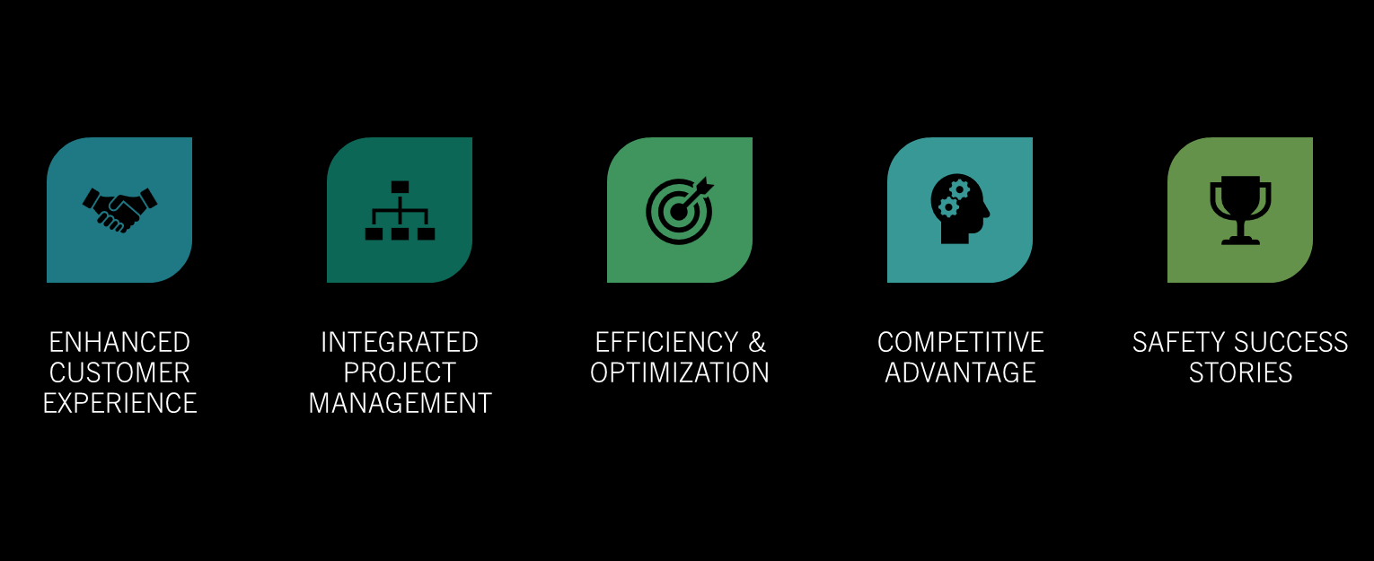
OPPORTUNITIES & OUTCOMES

Slide 15

Notes:
To further illustrate the potential of an AI-powered project management tool, consider a hypothetical case study where a homeowner embarks on a kitchen renovation. Using the tool, the homeowner receives a detailed budget estimate that incorporates costs for materials and labor, schedules the project phases based on contractor availability, and visualizes the renovation through AR. The result is a completed project within budget and ahead of schedule, showcasing the tool's effectiveness.

Slide 16
BONUS SLIDES
System Design
SDLC Process
Deployment Process
Priorities

Slide 17
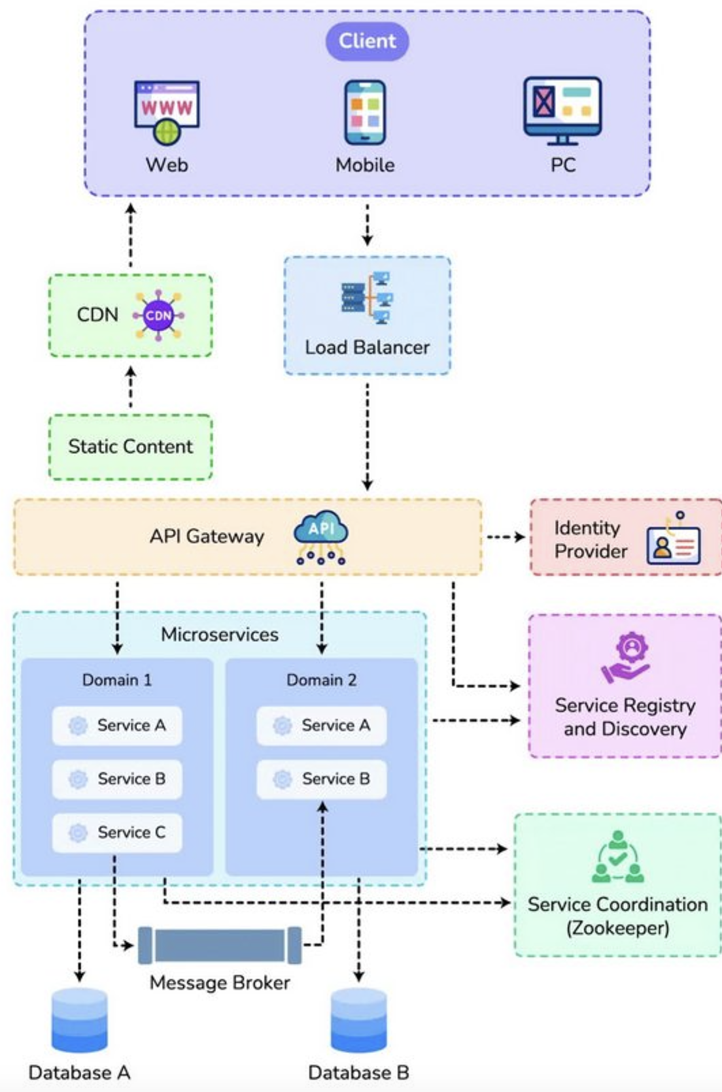
System design and S/w architecture
Microservices architecture
Browser Based
Mobile
Scalable
Service Oriented Architecture
Notes:
Coupled with anything else…

Slide 18
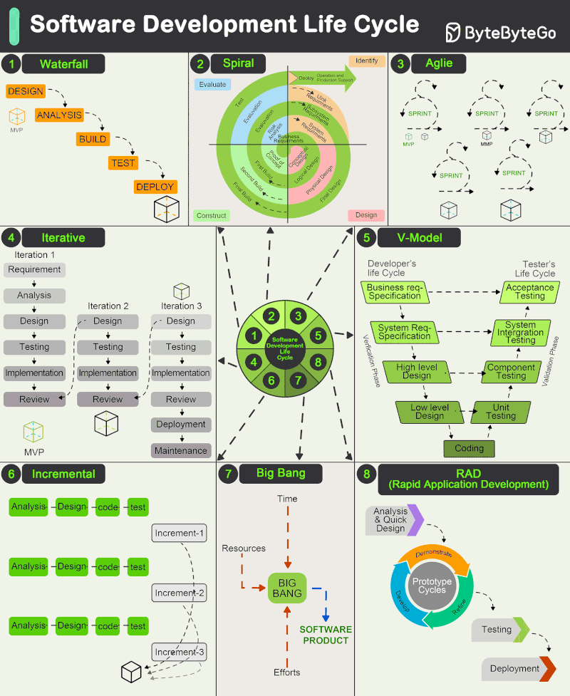
SDLC
Source: ByteByteGo’s

Slide 19
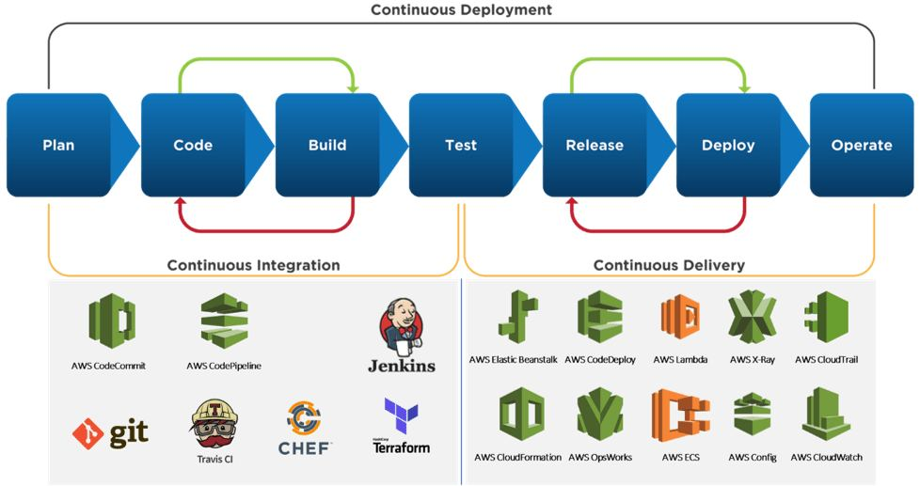
Deployment process

Slide 20
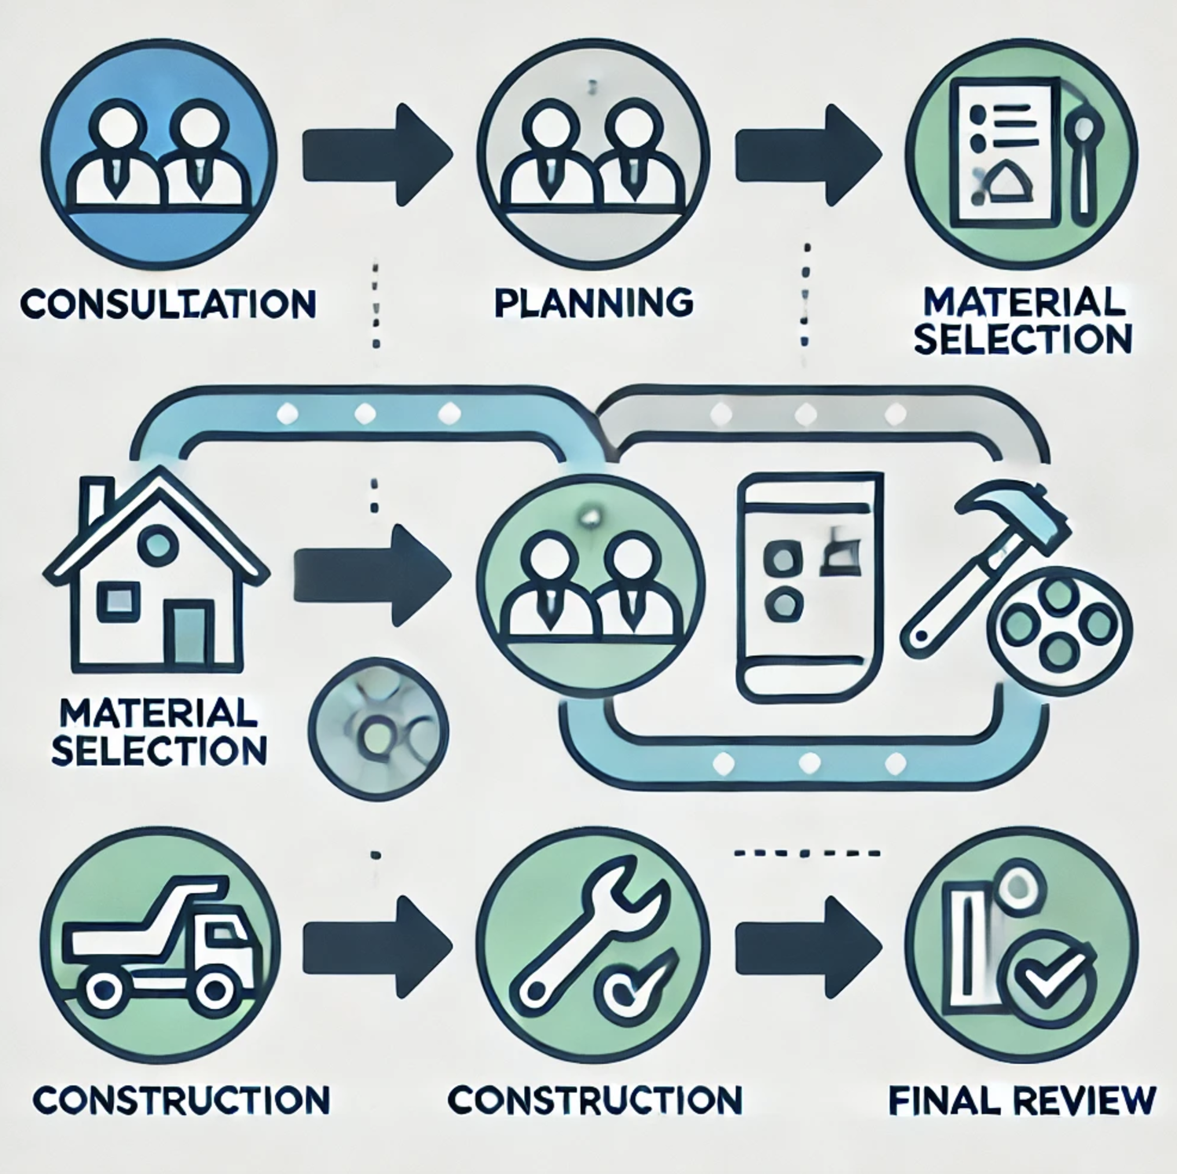
Process Flow
Five basic steps of home renovation service
Consultation.
Planning
Material Selection
Construction
Final review
Icon Source: https://www.freepik.com/icons
Notes:
To further illustrate the potential of an AI-powered project management tool, consider a hypothetical case study where a homeowner embarks on a kitchen renovation. Using the tool, the homeowner receives a detailed budget estimate that incorporates costs for materials and labor, schedules the project phases based on contractor availability, and visualizes the renovation through AR. The result is a completed project within budget and ahead of schedule, showcasing the tool's effectiveness.

